Slide 1


Economy: 6 pillars + theory + current + BES17 (pre cum Mains)
1.Banking, Fin, Insur.
6.HRD
2.Budget
3.BoP
4.Sectors
5.Infra
V1:c3,4
V1:c2,3, 6,9,11(GST),13
V1c:5
V1c:7(Textile),11(trade)
V1c:10
v1c:12, 14; Budget^Rail

Slide 2
BES175: Infrastructure (Transport): DEA classification
Concessional finance from PSB, FI, AIFI
NPA: RBI 5/25 restructuring
Tax related benefits.
Road
Air
Shipping
Rail
Transport
“Social” Infrastructure
Energy
Communication
Commercial Infra
Survey
Summit
GIFT city
Strategic Oil Reserve
Mega food parks
SEZ, TEE..
Rural Infra <BIPASA>
Urban Infra:
Water Sanitation: SBM
Notes:
2009
Ministry of Road Transport and Highways
Ministry of Shipping

Slide 3
NHAI: Act 88, Operations 95: Chairman + [6f+4p] members
Name | Responsibility of | Connects
Border Roads | BRO-Defense Min. | ☺
National Highways | Union | State capitals
Expressways (6-8 Lane) | Union | Major Cities e.g. Abad-Baroda
State Highways | State LIST: (Roads other than National highway) | State Capital to District HQ
District Roads | Zila Parishad | District HQ to tehsil and Blocks
Village Roads | GP | Villages to neighboring towns
NHAI
PM Gram Sadak
National Highway Accident Relief Service Scheme
Highway ministry gives cranes and ambulances to states.

Slide 4
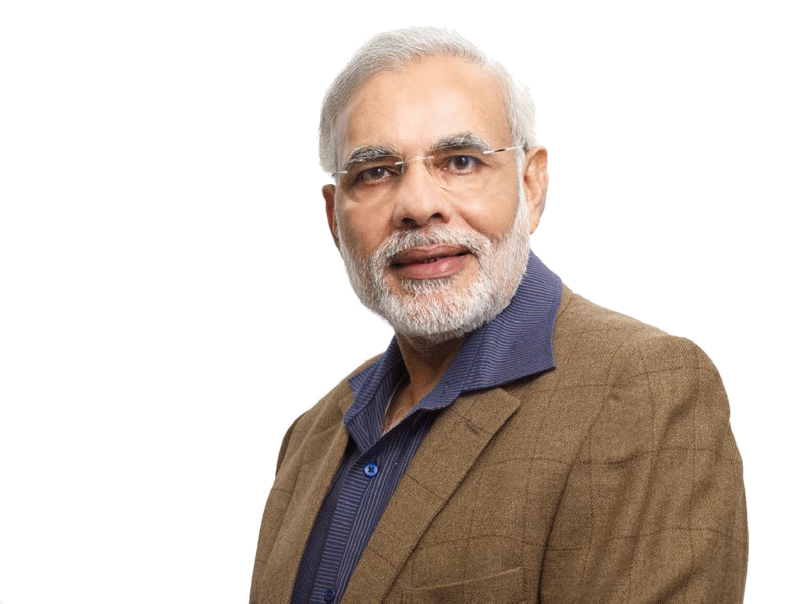
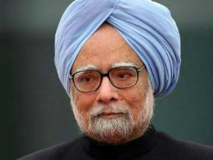

(2000) Vajpayee: PM Gram Sadak Yojana-I (Rural Dev Min)
All weather roads for all unconnected habitats
[census-2011]
500 People
250 People
Census
Tribal, NE, Desert, Scheduled area etc.
Use of local and green technologies e.g. waste plastic, geo-textile, iron slag, fly ash etc.
2013: PMGSMY-II
++ Consolidate and upgrade existing network also..

Slide 5
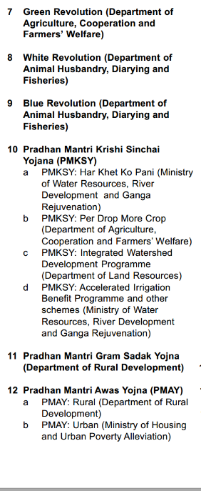
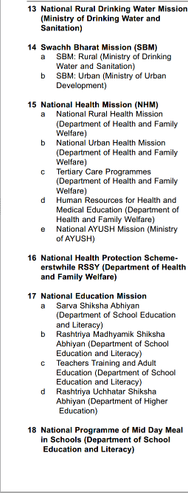
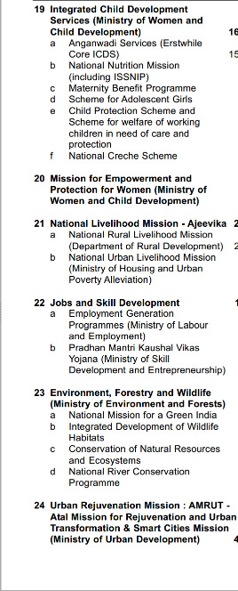
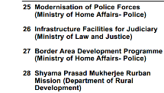
CSS: 28 schemes-6 core of the core= 22 “CORE” Schemes
Type
Core of the core
Core
Schemes
06
Special
22
General
Existing
Existing
90-10
60-40
Budget 2017
19k crores

Slide 6
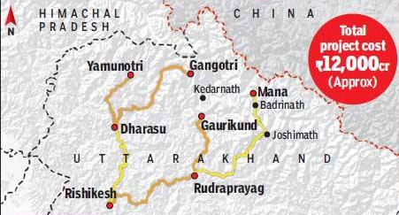
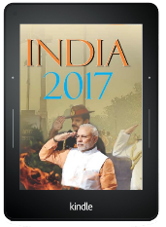
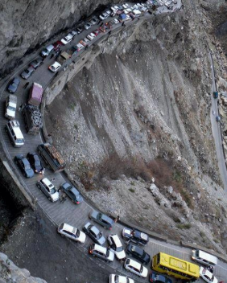
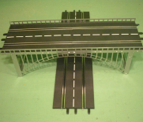
2016, December: Highway Min “Chardham Mahamarg Vikas Pariyojna”
Upgrade highways: 2 lanes
Landslide prone area: bypass
Helipads for evacuation
Under bridge, overbridged etc. prevent traffic bottleneck
Notes:
Modi launched in dec.
Kedarnath, Badrinath, Yamunotri and Gangotri in Uttarakhand
tunnels, bypasses, bridges, subways and viaducts to prevent traffic bottlenecks.
Prevent roads near landslide prone zones.
Chardham project includes developing 900 km of national highways in Uttarakhand at a total cost of Rs 12,000 crore.

Slide 7
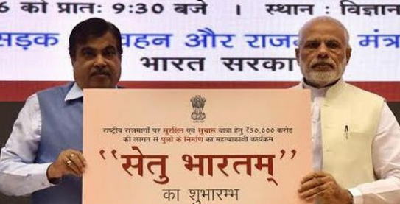
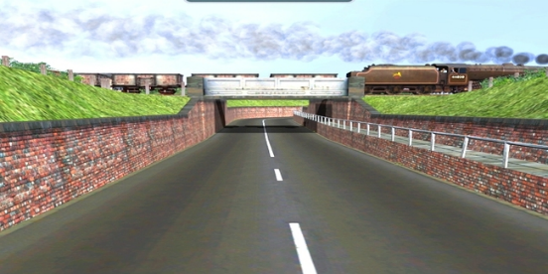
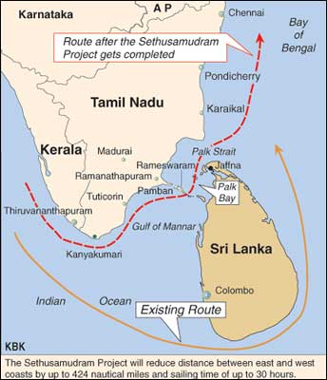
2016, May: Highway Min “SETHU BHARATAM”
By 2019: highways free of railway level crossing. Over bridge, under bridge…
+Indian bridge management system database under Noida’s bridge engg. Inst.
Sethu Samudram shipping canal (‘97 proposed)
between Palk bay and Mannar gulf to reduce time and fuel.
Anti: will hurt biodiversity and religious sentiments.

Slide 8
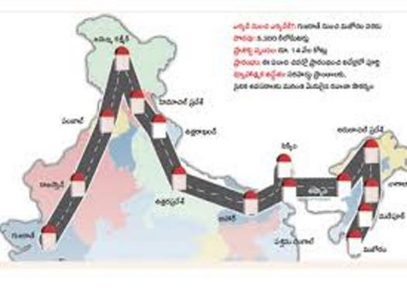
Bharat Mala: 80k crores, 7k km-road (build-upgrade); by 2019
Benefits
1.Strategic: move army, logistics, disaster mgmt in neighbor nations
2.economic: raw material, finished goods
Connect West (Gujarat)
To East
(Mizoram
Entire land border covered in this “necklace” / Mala
Connect with Coastal area (Maharashtra)
Connect with Coastal area (Bengal)
Sagar Mala for Port Infrastructure
Road & highway ministry
Border areas / tougher terrains
Ordinary areas
Defense Min.-> BRO
NHAI-> Bidders
Notes:
As per august data http://pib.nic.in/newsite/printrelease.aspx?relid=124217

Slide 9
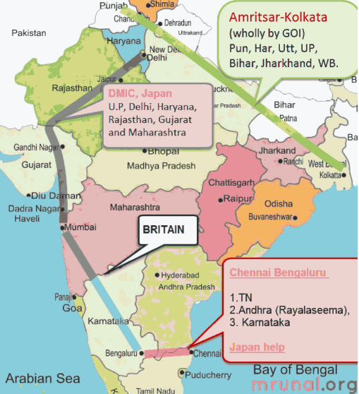
INFRA Corridors: by default “Commerce ministry”
A’bad Dholera special investment region
SPV between Guj. Gov and DMIC trust.
DMIC: Madhya Pradesh near Mhow
Vikram Udhogpuri
SPV: Shendra-Bidkin Industrial Park

Slide 10


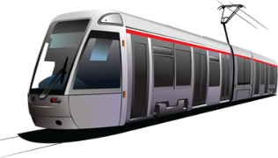
Golden vs. Diamond quadrilateral
Golden Quadrilateral | Diamond quadrilateral
1999 | 2014
under NHAI | under Rail budget
To connect four main cities of India Delhi-Kolkata-Chennai-Mumbai. ~6000km length | To connect major metros through High Speed Rails.
(length wise, longest to shortest) Kolkata-Chennai Delhi Kolkata Delhi Mumbai Chennai Mumbai | Proposed routes Mumbai-Ahmedabad Howrah-Haldia New Delhi-Patna Hydrabad-Chennai

Slide 11
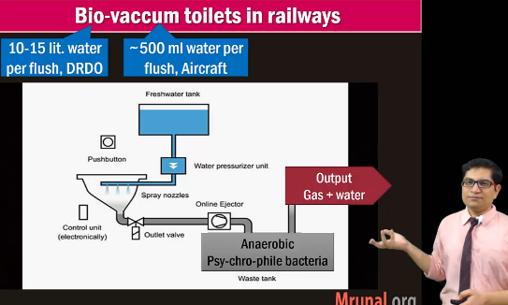
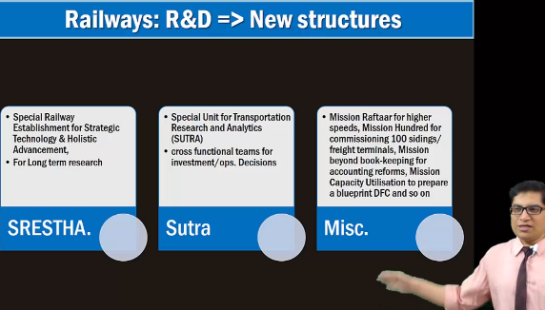
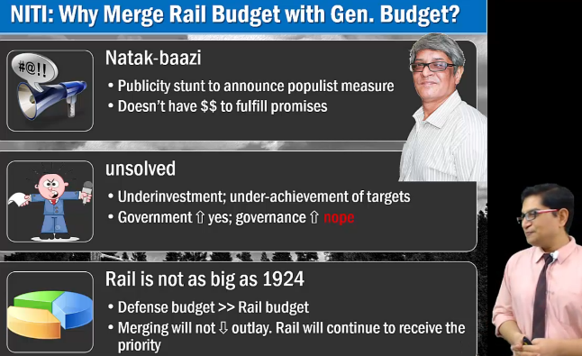
BES165: Rail budget theory self study
Railway Kayakalp board
(2015)
Ratan Tata, Innovation

Slide 12
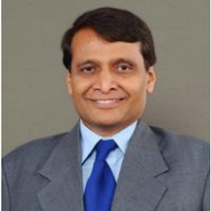
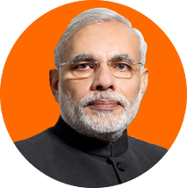
1921: William Mitchell Acworth -> ’24 separate -> ‘17 merged
BEFORE
1st Min. John Mathai (‘47) 1st Woman: Mamta
AFTER
Suresh PRABHU won’t present it 2 days before Gen.Budget ☺
00 dividend (Revenue receipt)
Capital: Gross BS from GB: “loan in perpetuity” -> dividend decided by Parliament Committee on rail convention (5%)
Demand for grants: 15 revenue + 1 capital
Only one demand for grant
Railways still responsible for its salaries, pension: Finmin may give “LOANS” (eRD ☹)

Slide 13
Rail budget General Budget 2017-> Rail provision
Passenger safety
2001: Vajpayee: Special rail safety fund. Non-lapsable. (but no money added post-2015)
2017: Rashtriya Rail Saranksha Kosh (20k PA x 5 years =1 LCr.).
Passenger Amnesties
PH friendly: lift, escalators
2019: bio toilets in all coaches.
Eliminate unmanned railway crosses. Upgrade signaling, tracks, coaches.
Coach Mitra app to register requirements from food to cleanliness.

Slide 14
Rail budget General Budget 2017-> Rail provision
No changes in fairs but service charge on e-tickets from IRCTC withdrawn. (digital payment system)
Ticket Fares
Centralized Defense Travel system : don’t wait in queues
Separate: defense pensioner platform
Finance
Cash accounting: when money is received, you report.
From henceforth, Accrual accounting: transaction finished within a FY. Will do this from March 2019.
New Metro Rail Policy and ACT
Disinvestment of IRFC, IRCON, IRCTC. <NEXT SLIDE>

Slide 15
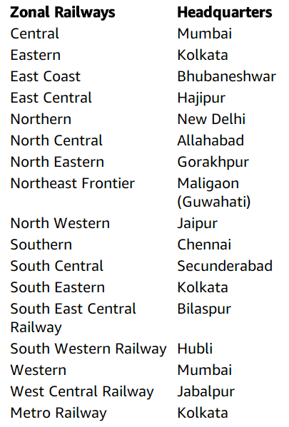
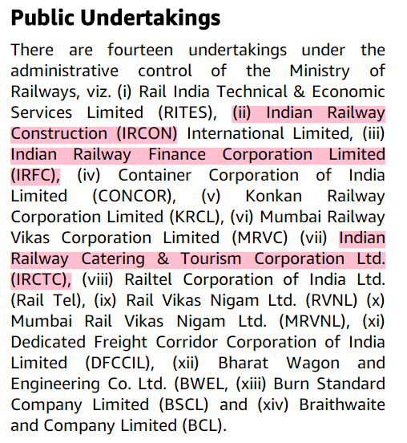
17 Zones (not IMP for UPSC)
14 PSU: pink will be listed

Slide 16
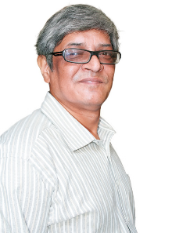
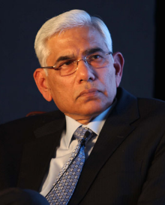
Railways: unified cadre system?
Train Ops
Back office
Traffic
Civil Engg.
Mech Engg.
Electrical Engg.
Signalling
Accounts
Personnel
Stores (Procure)
Bibek Debroy Committee, yes
atleast this, I’ll do to stop Departmental wars and rivalries
Vinod Rai Committee, yes/ deputation
Notes:
http://www.hindustantimes.com/nation-newspaper/only-two-railway-services-to-be-merged-for-now/story-r5dMSlBBuzV8g1nIu3XorN_amp.html

Slide 17
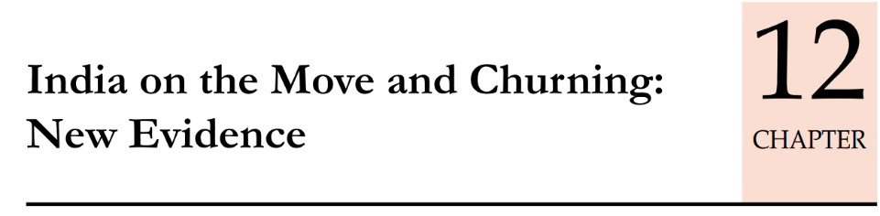
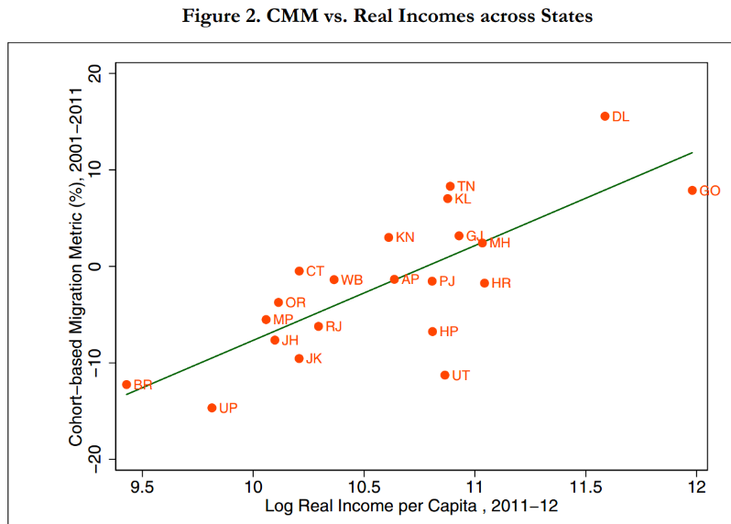
Poor states: out migration is more
China: 27 cr. Migrant workers. Remittance – growth of hinterland.
The cost of moving for people is about twice as much as it is for goods (RENT, facilities etc) –
Cohort Migration Metric (CMM): interstate mobility is more than Census data. And increasing each year,
Then income and consumption should increase but not happening. <governance challenges>

Slide 18
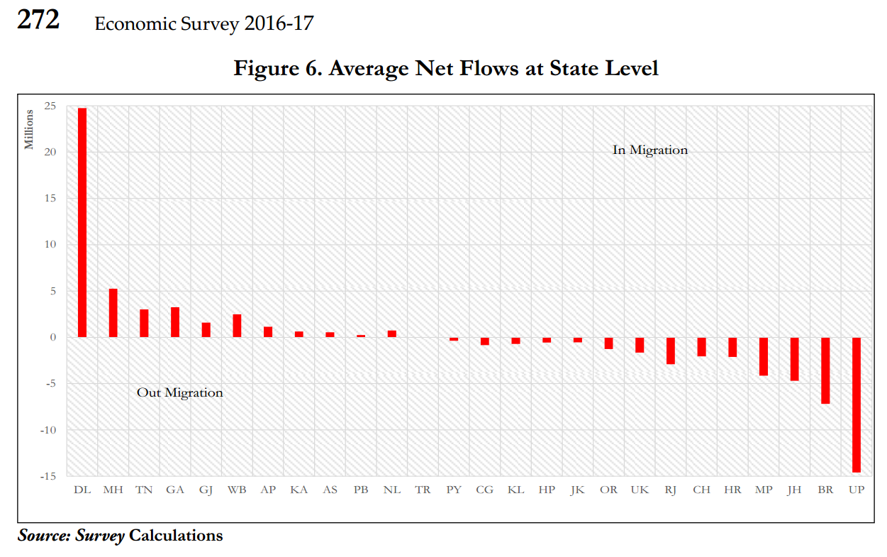
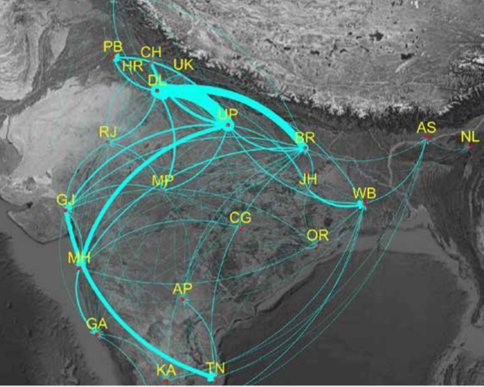
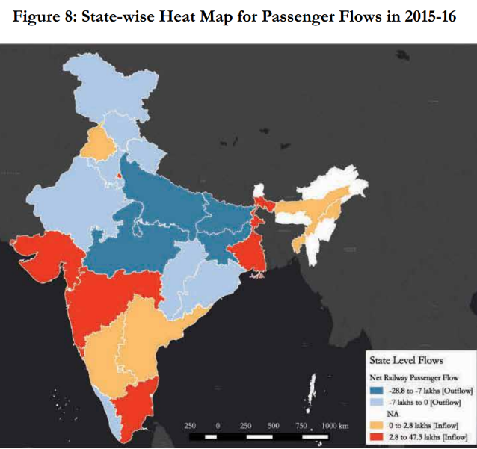
Train “unreserved seats”, language is not ‘barrier’.
Need social security, food security for the migrants.
Internal Remittances: 1.5 lakh crores = fin. Inclusion req.
Surat, vs Mumbai
Notes:
Gujarat and Maharashtra where Surat has started acting as a counter magnet region to Mumbai and attracts migrants

Slide 19
BES175: Infrastructure (Transport): DEA definition:
Road
Air
Shipping
Rail
Transport
“Social” Infrastructure
Energy
Communication
Commercial Infra
Survey
Summit
GIFT city
Strategic Oil Reserve
Mega food parks
SEZ, TEE..
Rural Infra <BIPASA>
Urban Infra:
Water Sanitation: SBM
Notes:
2009
Ministry of Road Transport and Highways
Ministry of Shipping

Slide 20
Civil Aviation Ministry (Yearbook)
Budget 2017:
monetization of assets (sellout / rent land, building) use money for Development
Tier-II O&M via PPP
DGCA: air traffic, licensing
Bureau of civil aviation security
Commission of Railway safety
Pawan Hans, offshore oil, hill areas
Air India -> Hotel corp. ltd.
AAI airport: 125 airports
Civil aviation requirement (CAR)
Airline can throw off unruly passengers. Now draft rules for “no fly list” (May 2017)
Notes:
http://www.crs.gov.in/
Directorate General of Civil Aviation

Slide 21
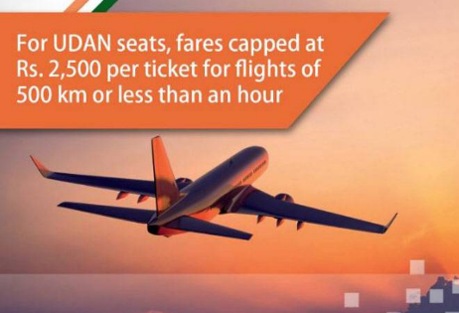
UDAN: Ude Desh Ka Aam Naagrik under national civil aviation policy 2016
Find low traffic airports in Tier-II and III cities.
Airline bids for route. Five operators won: Airline Allied Services, SpiceJet, Air Deccan, Air Odisha and Turbo Megha.
They would be operating 19-78 seater aircraft.
50% seats reserved for UDAN (Rs.2,500/- cap)
Government pays the loss to Airline loss
Class I: 100,000 and above; (MAX CITIES HERE)
Class II: 50,000 to 99,999;
Class III: 20,000 to 49,999;
Class IV: 10,000 to 19,999;
Class V: 5,000 to 9,999
Class 6 Less= >5k rural areas

Slide 22
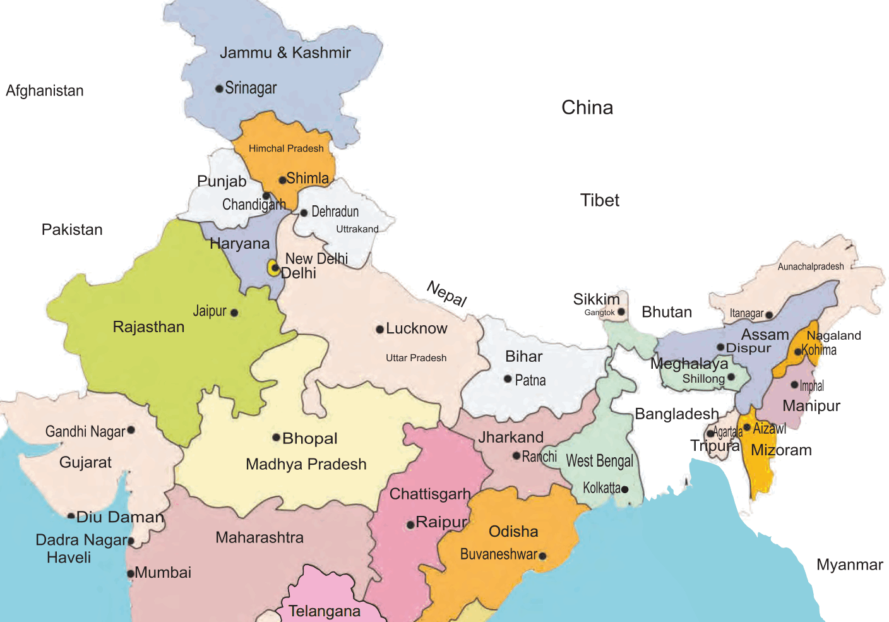

Viability gap fund (VGF) for 7 years “official name” : Regional connectivity fund under AAI
+ Union Levy (5000/)-
+ states contribute (10-20%)
Major routes: addl levy 5000 per departure from airline
Cross subsidization
Pay losses here
Jet Airways et al went to court against this.
[case pending, but to placate 8500->5k? ]
Notes:
Earlier it was 8500 but now reduced.

Slide 23
Civil Aviation Policy 2016: Regional connectivity
Union
Max. service tax 10%
VGF: 80:20 / 90:10 – through regional connectivity fund via levy on air passengers
State have to
Max. 1% VAT on ATF
Water, sewage etc. @concessional rates
Fire & security @FREE
If 1 middle family x 1 air trip per year => 30 cr ticket sales
ELSE more Kingfisher like “shutdowns”
Notes:
ment multiplier are 3.25 and 6.10 respectively.
if every Indian in middle class income bracket takes just one flight in a year, it would result in a sale of 35 crore tickets,
This will be possible if the air-fares, especially on the regional routes, are brought down
enable 30 crore domestic ticketing by 2022 and 50 crore by 2027, and international ticketing to increase to 20 crore by 2027. Similarly, cargo volumes should increase to 10 million tonnes by 2027.
promote tourism, increase employment and lead to a balanced regional growth.
RCS will be made operational only in those States which reduce VAT on Aviation Turbine Fuel (ATF) at these airports to 1% or less for a period of 10 years.
No-Frills Airports will be done at an indicative cost of Rs 50 crore to Rs 100 crore, without insisting on its financial viability.
Service tax on tickets will be levied on 10% of the taxable
police and fire services free of cost. Power, water and other utilities will be provided at substantially concessional rates.
VGF will be shared between MoCA and the State Government in the ratio of 80:20. For the North Eastern States, the ratio will be 90:10.
payment of the full amount of VGF will be made to the airline operator from the Regional Connectivity Fund (RCF)

Slide 24

Aviation Policy 2016
skilling
Commercial pilot license: ~30 lakh fees.
Still, Lack of regular employment: Tweaking labour contract acts
Subsidized training @public, private academies, 3.3 lakh jobs by 2025
security
DGCA more powers to inspect & fine
Private security agency can be used- must register under PASARA Act 2005, CISF will train them by charging fees.
Misc.
Max. airfare per hr : Rs.2500/-
Route Dispersal Guidelines (RDG) of ‘94 tweaked = more air connectivity to J&K, hill states, island UT. Union to give subsidy to airlines.
Chicago Convention 1944: bilateral rights, open skies
Climate change, energy audit.
@costal areas Seaplane tourism, air-sport
5/20 rule scrapped before flying international. (2014)
Notes:
Started in 2004
can run intl. flight onlyIF min.
20 aircrafts
5 years domestic xp.
NEW: 5 years exp eliminated, technical tweaking.

Slide 25
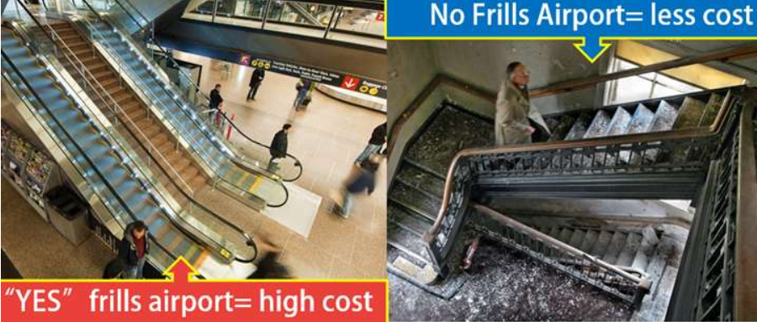
2014: No frills airport by AAI
PPP and VGF

Slide 26
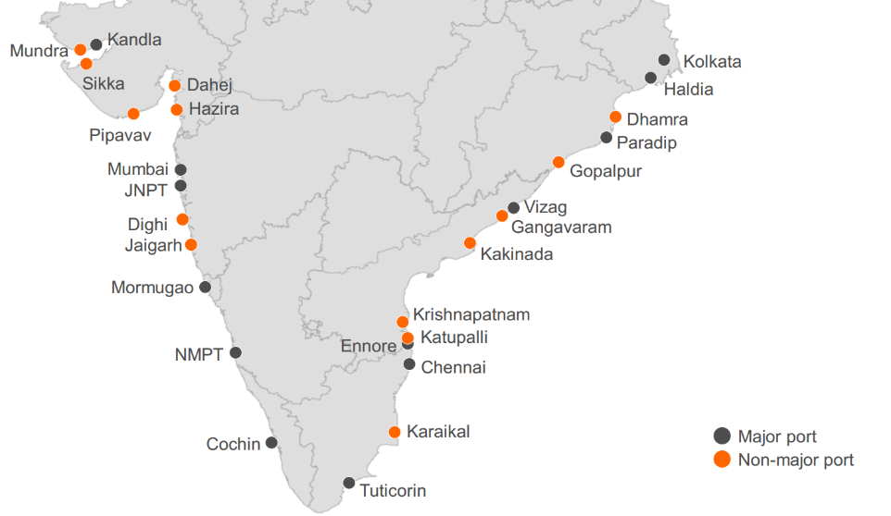
12 major and 200+ minor ports
Artificial / natural | NAME | STATE
N | Jawahar Nehru, Nhava Shewa | MH (2)
N | Mumbai, 1873
N | Kandala, Kutch. Tidal port: in 50s because Karachi port lost in Partition | Guj (1)
N | Mormugao. Tidal Port, @Zuvari estuary, iron-ore export | Goa (1)
A | New Mangalore. Deep water, all weather | Karnataka(1)
N | Cochin/Kochi. Willingdon island | Kerala(1)
 | Total Major Ports (West Coast) | 6

Slide 27
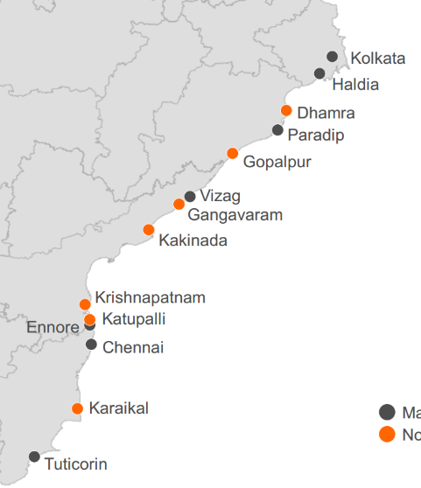
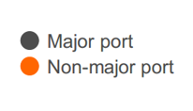
12 major and 200+ minor ports
A/N? | NAME | STATE
N | Haldia | Kolkata. Riverine port Oldest major port of India# Need constant dredging to keep depth. | WB(1)
N | Vishakhapatnam. & Eastern Naval command | AP(1)
A | Paradeep (manmade lagoon) | Odisha(1)
N | Tuticorin | TN (3)
A | Chennai (all weather)
A | Ennore (private, under companies Act)
N | Port Blair (Southernmost). Declared 13th major port in 2010. named after British officer Lt. Archibald Blair | A&N(1)
 | Total Ports East Coast | 7

Slide 28
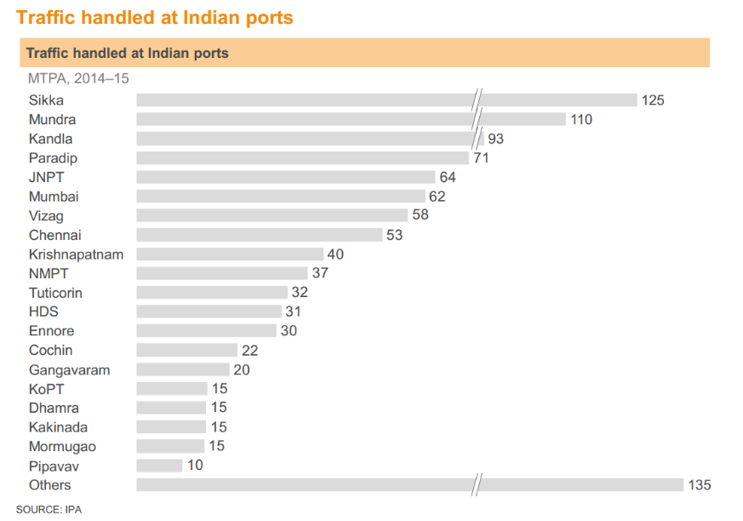
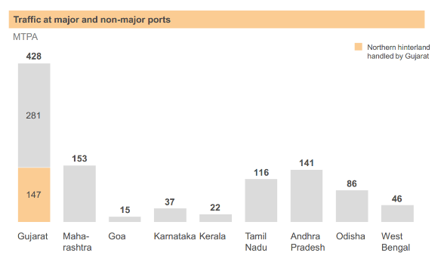
Major Ports = parliament act = “SARKARI inefficiency”
Minor ports free to decide their tariff charges and re-invest for modernization.
Minor ports handling major cargo!
Budge 2014: Ports will be corporatized, but now Nitin Gadkari says Ports will not be corporatized
Not ease of doing biz?

Slide 29

Maritime Agenda 2010-20: 100% FDI in port Development,
3130 MT port capacity, Improve non-major ports.
2003- Vajpayee, 2016 Modi revive
Similar to cash transaction: 95% by volume and 68% by value done via shipping. GHG…

Slide 30
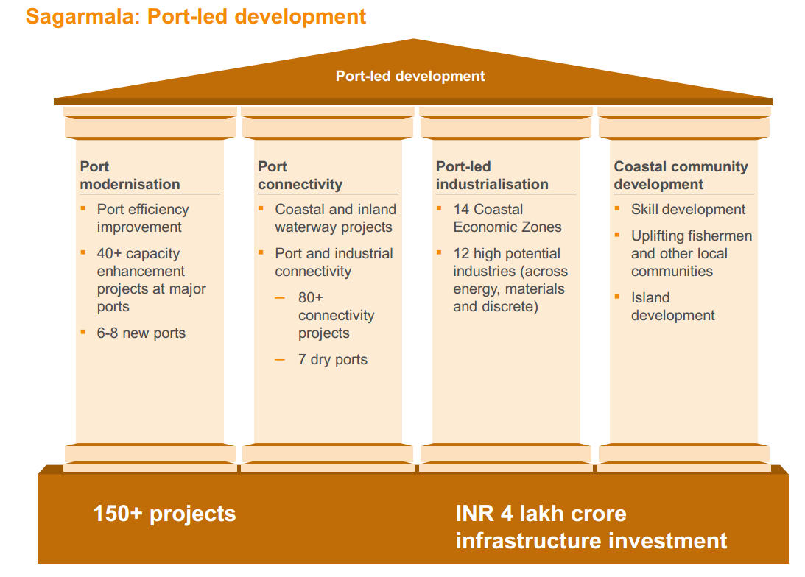
3000+ MT capacity by FY25
1 cr new jobs.

Slide 31
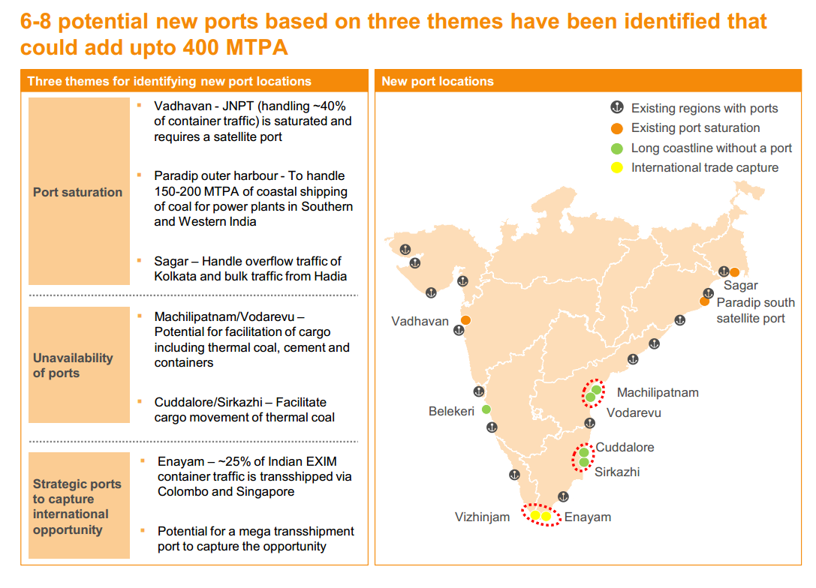
SAGARMALA: 6-8 new ports

Slide 32
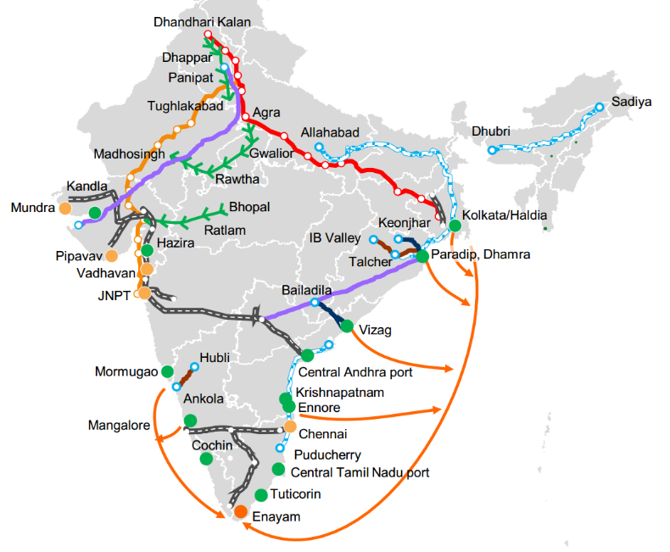
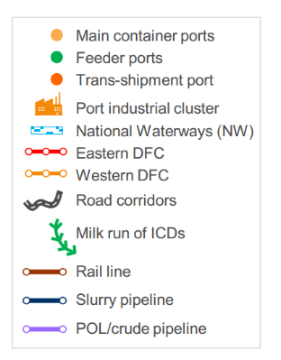
Improve port to hinterland connectivity: road, rail, inland water

Slide 33
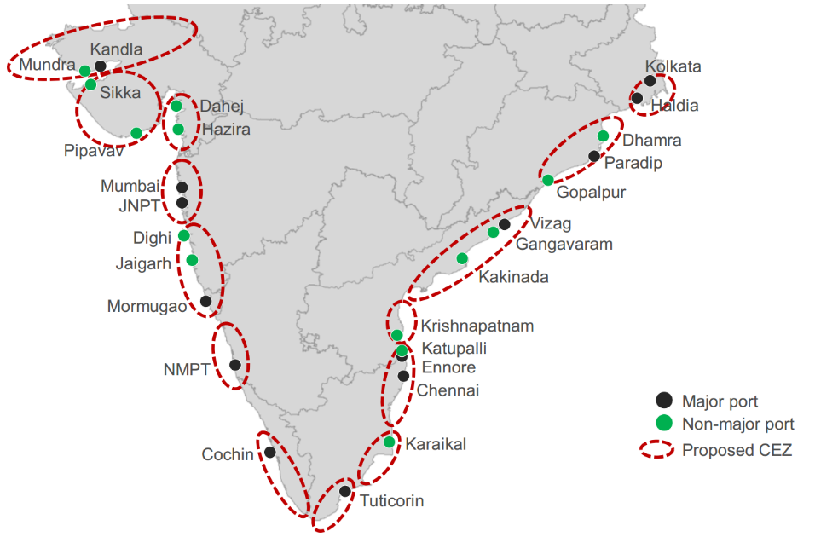
SAGARMALA: Coastal Economic ZONE (CEZ)
SAGARLMALA
Development Company (SDC)
SPV: under Shipping min.
Authorized capital: 1k cr

Slide 34
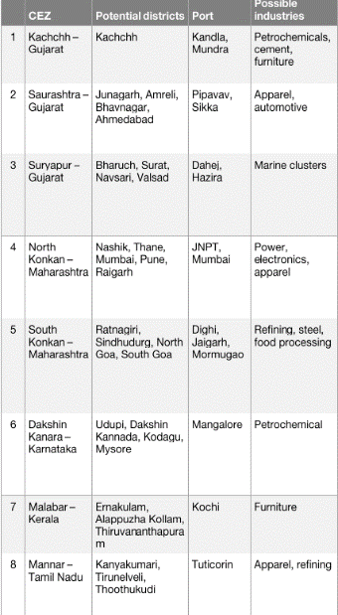
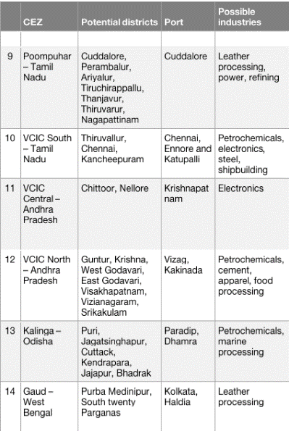
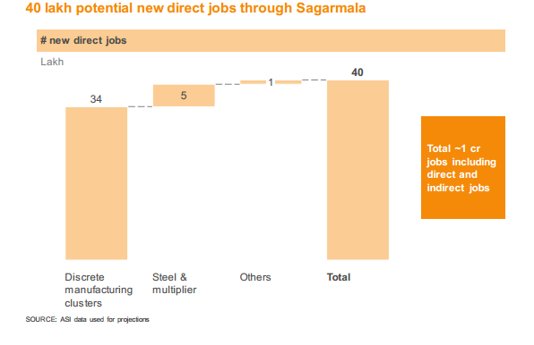
SAGARMALA: Coastal Economic ZONEs & Jobs
Skill Development programs for coastal communities

Slide 35
Mock Question for Prelims
Which of the following are objectives of SAGARMALA plan launched in 2016?
Creation of coastal economic zones (CEZ)
Skill Development of coastal communities
Corporatization of major ports.
Answer choices:
a) Only 1 and 2 (b) Only 2 and 3
c) Only 1 and 3 (d) all of them

Slide 36
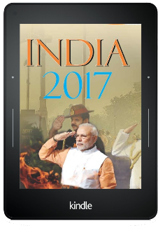
IYB17: Ship registration
Greece
Japan
German
China
Singapore
OPEN Registry
Owner need not be of same country, where ship is registered.
Coastal Shipping
Regulated under Merchant Shipping Act’58
Not required to pay lighthouse dues
Dredging Corporation of India ‘75
PSU under Shipping Ministry
for major, minor and NAVY

Slide 37
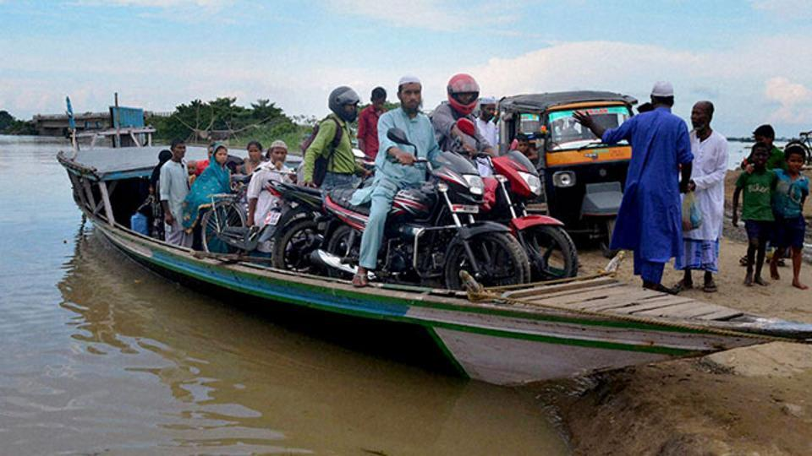
Inland Water Transport: 14,500 kms of navigable waterways
Environment friendly
Cost effective

Slide 38

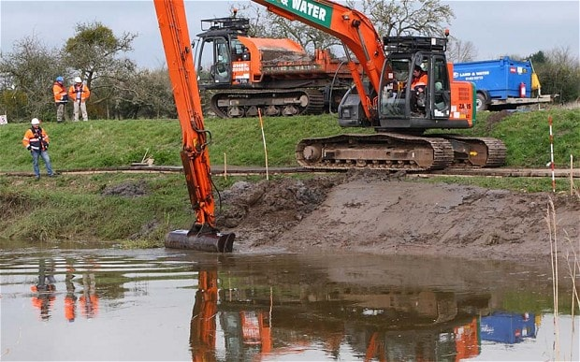
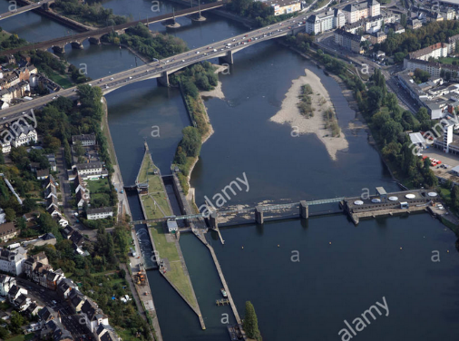
So, WHY this Anomaly?
Himalayan Rivers: constant dredging required
Peninsular Rivers: Min. water flow ☹
Embankments with locking barrages

Slide 39

National Waterways act 2016
Shipping ministry
Union Entry #24: inland waterways- shipping and navigation
Repealed earlier acts for individual waterways.
111 NW notified. Although only following are operational

Slide 40

Jal Marg Vikas
+$World bank

Slide 41
Mock Question for Prelims
Find correct pair(s)
Jal Marg Vikas project: upgrading National Waterway on Brahmaputra
Sethu Bharatam project: making Indian highways free of railway level crossing.
Chardham Mahamarg Vikas Pariyojana: improving highway connectivity to the four pilgrim cities of Badrinath, Dwarka, Puri and Rameswaram.
All of the above.

Slide 42
BES175: Infrastructure (Transport): DEA definition:
Road
Air
Shipping
Rail
Transport
“Social” Infrastructure
Energy
Communication
Commercial Infra
Survey
Summit
GIFT city
Strategic Oil Reserve
Mega food parks
SEZ, TEE..
Rural Infra <BIPASA>
Urban Infra:
Water Sanitation: SBM
Notes:
2009
Ministry of Road Transport and Highways
Ministry of Shipping

Slide 43
Implicit carbon tax
Excise on per lt. Petrol
Excise on per lt. Diesel

Slide 44

Same thing via table.. We are more ‘serious’ than MOST G20!!

Slide 45



2006: UK FinMin-> Stern Review on Economies of Climate Change
Sir Nicholas Stern,
Ex-Chief Economist @WB

Slide 46


India’s commitment: won’t have higher per capita emission than AE
GERMANY
We are a good global citizen against climate change.

Slide 47

UNFCCC summits
2018, Poland
2017, Bonn
2015, Paris
2016, Marrakech
Montreal Protocol Parties
Kigali, Rwanda 2016
2014, Lima

Slide 48


SELF STUDY: BES165 <environment playlist>
2nd October, 2016
We ratified
2017, June Week1: Trump announced USA will quit Paris treaty. but not teaching for prelims, because I think prelim paper already set. we'll see USA- withdrawl's impact on India, for mains later on.

Slide 49


November
Parties to UNFCCC
Parties to Kyoto
Parties to Paris
Strait of Gibraltar
UN Non-self governing territory claimed by Morocco & Algeria

Slide 50
Marrakech Outcome: “decided that we’ll decide next time”
Commitment (INDC)
2018: “Facilitative dialogue” – create a “Rule book” to cross check everyone is doing their INDC assignment
Marrakech Action Proclamation: give urgent priority to all these things! (but mostly CoP of distraction by Trump)
$
Donors: $100 bn a year by 2020 (public + private)
Kyoto -> Carbon Trading & CDM-> 2% “Adaptation Fund” (2001).. What to do now? Will decide in 2017
Global environment Facility -> Capacity-building Initiative for Transparency (CBIT): trust- got 50 million.
Loss and Damage ..<NEXT SLIDE>
Update: June week1, 2017: Trump announced USA will quit Paris treaty. क्योकि एक बार जो ट्रम्पने 'प्रदुषण फ़ैलाने commitment' कर दी, तो फिर वो खुद की भी नही सुनता.
Notes:
nationally determined contributions,

Slide 51

UNFCCC Warsaw Summit (2013) @Poland
Climate Change leads to
Loss
Damage
Can’t repair
Can repair
Death, ecosystem, Area
Forest cover, global warming.
3rd world wants 1st world to pay $$ for “Loss and Damage”.
but 1st world won’t accept any ‘legally binding liability’.
Marrakech Summit (2016)
Start estimation from 2017.
Five year work plan for compensation etc.

Slide 52

Misc. outcomes
UNFCCC 2016
Climate Vulnerable Forum (47 poorest nations) committed to 100% RE ASAP.
2050 Pathway platform: to help countries make their long term plans.
Parallel: Swiss Global Infrastructure Basel Foundation (GIB) presented “SURE”: Standard for Sustainable and Resilient Infrastructure. “index” for developers and investors.
Orphan Issues: talked in Paris but none assigned responsibility- here too mostly remained “orphan”.
Next summit in Bonn, Germany: Co-Chair Fiji.

Slide 53

Energy
Solar park development phase-II: 20,000 MW additional.
Strategic oil reserves @Rajasthan and Odisha <REF BES173/BOP: CAD lecture>
<SELF STUDY environment playlist.>
Budget 2017

Slide 54
BES175: Infrastructure (Transport): DEA definition:
Road
Air
Shipping
Rail
Transport
“Social” Infrastructure
Energy
Communication
Commercial Infra
Survey
Summit
GIFT city
Strategic Oil Reserve
Mega food parks
SEZ, TEE..
Rural Infra <BIPASA>
Urban Infra:
Water Sanitation: SBM
Notes:
2009
Ministry of Road Transport and Highways
Ministry of Shipping

Slide 55

SELF STUDY
Current
Lok Sabha, RS TV merger after VP is gone (his pet project)
Budget 2017
Passport: head post office
+IPPB
Current
BSNL-MTNL
merger
Notes:
RS TV as it is a pet project of the Rajya Sabha chairman Hamid Ansari.
PMO wants to wait for one more year so that the Dr Ansari's successor will take a call on the continuance of RS TV. Talks are on whether it should be merged with Lok Sabha TV and have one channel for both houses. BJP leaders are cribbing about the news content of RS TV which has always been encouraging negative pictures about the ruling party.

Slide 56
Numismatics Philately: 2016-17 (Jio 4g Happy New Year)
Ganesh pol
Amer Fort, Rajasthan
Both Mughal, Rajput style
Gateway to king’s private chamber.
Glass window
Udaipur’s Bangore ki haveli (18th cent.)
Blue pottery
JAIPUR
Peacock GATE:
Jaipur ‘s Chandra Mahal
Autumn season, Vishnu dedicated

Slide 57
Philately: 2016-17 (Jio 4g Happy New Year) Buddhism
Chaitya hall
Karle caves, Maharashtra 1st BC, Buddha’s life.
Bodhi Tree (peepal, ficus tree):
Sandstone relief
Sanchi Stupa complex (MP)
350th Prakash Utsav
Guru Gobind Singh: Takht Sri Harimandar Sahib-ji @Patna
<not part of happy new year series>

Slide 58
Philately: 2016-17 (Jio 4g Happy New Year) CRAFTING
Jardosi carpet
Agra, silver, metal wires
Peitra Dura
Black marble art
Mughal buildings
Thanjavur painting
Wooden plank (3d)
TAMILNADU

Slide 59
Philately: 2016-17 (Jio 4g Happy New Year) CRAFTING
Pashmina
Cashemere goat wool, handspun shawl
Chhau Mask
Classical dance @Odisha, Bengal, JH; @Chaitra Parva
Each mask – character from Puran
SAROTA
Areca nut cutter

Slide 60






2016: METAL CRAFT
Chola period.
Brass work
Jaipur “Koftagari”,
Moradabad (UP),
Palitana (GUJ)
Nakkashi on white metal: Kashmiri
Dokra Metalcraft: Andhra Pradesh, Odisha, Madhya Pradesh

Slide 61






2017: 16 headgears of India ☹(only imp covered)
GI status, 2009
KASHMIRI
Assam, Palm like trees
BIHAR

Slide 62





2017: 16 headgears of India ☹(only imp covered: TRIBAL)
Naga Warrior
Angami Naga, Bamboo
Chhattisgarh &
Central India
Brokpa tribe in Ladakh
For women

Slide 63




2017: philately: army and colleges
“Super Hercules” C-130
IAF-2011: 20 tones advance mobility – highest airfield landing possible
Uttarakhand flood: Op. Rahat
Hudhud: Vishakha Pattanam
Philippines Haiyan cyclones etc.
1917: Lala Ramjas’s son Rai Kedarnath
1922: brought under university of Delhi
200 years in Indian army
1912, New Delhi (DU)

Slide 64

Lady Bird
Philately 2017
Family “Coleopterans” (कोलियो-टेरांस): front wing hard cover to rear wing (Greek word)
British name “Lady’s bird / beetle”
Undergo Metamorphosis
Prey: aphid, scale insects and other agri. Insects. <PEST CONTROL>

Slide 65


Philately 2016
Everywhere except Arctic and Anta-
Ornamental usages since Confucius's time
Complex flower structure for Biotic cross pollination : Hence “evolution”: more superior than other plants.
Mycorrhizae fungus: symbiotic relation – they supply carbohydrates. [although capable for photosynthesis]
Himalayan “Endangered”
Maharashtra, Project Tiger
Andheri river flows through park.

Slide 66
2016: Near threatened birds
Flycatcher: W.Ghat
Flycatcher: W.Ghat
Andaman: Woodpecker
Nicobar Pigeon

Slide 67

2016: Personalities
Albania: Agnes Bojaxhiu
31st Oct
Calcutta
79’: Nobel Peace
’16: Canotisation

Slide 68


Budget 2017: Commemoration
100 years
Of SABARMATI Ashram with Guj. Government
200 years
1817 uprising of soldiers by Buxi Jagabandhu in Khordha, odisha
100 years of
Champaran Satyagrah
French Author
Nobel Prize
for Literature in 1915

Slide 69
‘77: NIC-> 2006: NeGP-> 2015: Digital India Mission (till 2019)
Department of Electronics and Information Technology
National Academic Depository for school LC, Mark sheet etc.
Similarly medical repository..
BHARATNET for GP
Broadband Highway
Universal Mobile
E-Governance
E-Kranti
Info. to all
IT jobs
Early Harvest
ZERO import
Public Internet
NIC: “E-Sampark” platform: depts. Can send e-letters, SMS to citizens [design poster etc.]

Slide 70

NOFN to BHARATNET
2011: UPA starts
2015: Modi rename
National Optical Fiber Network
To connect broadband to all GP
BHARAT NET
Under DoT
Funding?
Universal service obligation fund (USOF) on mobile operators
-> SPV: Bharat Broadband Network ltd (BBNL)
2017: Budget [10k Cr.]
By FY18: 1.5 lakh GP connected (out of total 2.65 lakh GP)

Slide 71

ICT: how to spread digital literacy?
Budget 2016 [Ministry of electronics]
PMGDISHA: PM gramin Digital Sakshrta Abhiyan.
Budget 2017
Separately, Intel: Ek Kadam Unnati ki aur (@rural CSC Kendra)
Register 200-300 people per GP and train them.
Digigaon: telemedicine, education etc. will be delivered under digital India mission

Slide 72


Self study for Mains: E-governance (Youtube)

Slide 73



2014: Modi asked ISRO to develop a satellite for SAARC.
2017, May: GSAT-9 launched from Sri Harikota, Andhra Pradesh
GSAT-9 is a Geostationary Communication
TV, DTH, VSAT, tele-edu, medicine etc. < ku –band>
Satellite for 8 SAARC nations minus PAK
100% India funding. Wt. 2230 kg
While this was launched in 2017-May, but news already appeared in theHindu in 2016 so I'm covering. Many other satellites also launched, but you do them in self study. I consider GSAT-9 as most prestigious among them, hence teaching. [If I try to cover all, then won't be able to finish the BES17 on time!]
Geosynchronous Satellite Launch Vehicle (GSLV-F09) CRYOGENIC power

Slide 74
BES175: Infrastructure (Transport): DEA definition:
Road
Air
Shipping
Rail
Transport
“Social” Infrastructure
Energy
Communication
Commercial Infra
Survey
Summit
GIFT city
Strategic Oil Reserve
Mega food parks
SEZ, TEE..
Rural Infra <BIPASA>
Urban Infra:
Water Sanitation: SBM
Notes:
2009
Ministry of Road Transport and Highways
Ministry of Shipping

